Slide 1



UNIVERSITY INSTITUTE OF ENGINEERING
COMPUTER SCIENCE ENGINEERING
Bachelor of Engineering
Design and Analysis of Algorithms(CST-302/ITT-302)
Prepared By: Amrita Chaudhary (E8745)
Topic: Queue
DISCOVER . LEARN . EMPOWER

Slide 2
Learning Objectives & Outcomes
Objective:
To use FIFO technique.
To perform all manipulation operations on data structures.
To perform traversal of Queue.
Outcome:
Student will understand
stacks and its operations.
Application of Stack

Slide 3
Queue
Queue is a linear structure which follows a particular order in which the operations are performed. The order is First In First Out (FIFO). A good example of queue is any queue of consumers for a resource where the consumer that came first is served first.

Slide 4
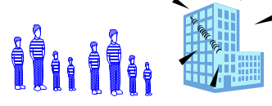
Queues
Stores a set of elements in a particular order
Queue principle: FIRST IN FIRST OUT
= FIFO
It means: the first element inserted is the first one to be removed
Example

Slide 5
Queue Applications
Real life examples
  Waiting in line
  Waiting on hold for tech support
Applications related to Computer Science
  Threads
  Job scheduling (e.g. Round-Robin algorithm for CPU allocation)

Slide 6
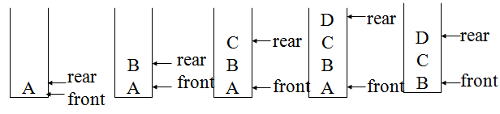
FIRST IN FIRST OUT

Slide 7
Operations on Queue
Mainly the following four basic operations are performed on queue:
Enqueue: Adds an item to the queue. If the queue is full, then it is said to be an Overflow condition.
Dequeue: Removes an item from the queue. The items are popped in the same order in which they are pushed. If the queue is empty, then it is said to be an Underflow condition.
Front: Get the front item from queue.
Rear: Get the last item from queue.

Slide 8
Types of Queues
Circular Queue
Priority Queue
De-queue

Slide 9
Circular Queue
In a normal Queue, we can insert elements until queue becomes full. But once queue becomes full, we cannot insert the next element even if there is a space in front of queue. Circular Queue is designed to overcome the limitation of Simple Queue.
Circular Queue is a linear data structure in which the operations are performed based on FIFO (First In First Out) principle and the last position is connected back to the first position to make a circle. It is also called ‘Ring Buffer’

Slide 10
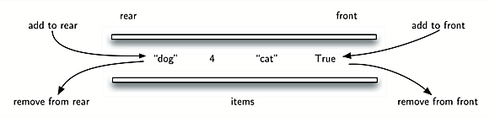
DeQueue
Double ended queue allows insertion and deletion from both the ends i.e. elements can be added or removed from rear as well as front end.

Slide 11
Priority Queue
Priority queue is a type of queue where each element has a priority value and the deletion of the elements is depended upon the priority value. In case of max-priority queue, the element will be deleted first which has the largest priority value and in case of min-priority queue the element will be deleted first which has the minimum priority value.

Slide 12
REFERENCES
Text books:
Cormen, Leiserson, Rivest, Stein, “Introduction to Algorithms”, Prentice Hall of India, 3rd edition 2012. problem, Graph coloring.
Horowitz, Sahni and Rajasekaran, “Fundamentals of ComputerAlgorithms”, University Press (India), 2nd edition
Websites:
https://www.studytonight.com/data-structures/queue-data-structure
https://www.geeksforgeeks.org/queue-data-structure/

Slide 13
Summary
  Queues:
  Types of queues
  Operations on queues

Slide 14
THANK YOU

